Slide 1

EU Gender Equality Law: developments, challenges and ideas for the future
Dr. Alexandra Timmer
Utrecht University
28 October 2025
a.s.h.timmer@uu.nl

Slide 2


Outline
Historical development of EU Gender Equality Law
Core concepts and their challenges
Gender
Equality
Discrimination
Achievements and ideas for the future

Slide 3
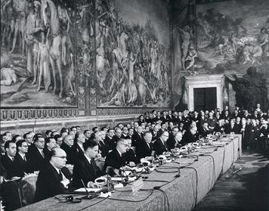
1. Historical development

Slide 4
Brief history of EU equality and non-discrimination law
Article 119 Treaty of Rome (1957)
Defrenne Cases
Treaty of Amsterdam (1997)

Slide 5

It all began with article 119 EEC Treaty (1957) – Equal Pay
“Each Member State shall . . . ensure . . .the application of the principle that men and women should receive equal pay for equal work.
Background was purely economic: focus was on creating internal market

Slide 6



Gabrielle Defrenne
Facts: compulsory retirement of air hostess at age 40, employed by airline Sabena

Slide 7
Defrenne cases were hugely important in development of EU (gender equality) law
Case 80/70 Defrenne I (1971)
Definition of pay under Art. 119 EEC
Case 43/75 Defrenne II (1976)
Art. 119 EEC:
Both economic and social objective
Recognition of Direct effect
Case 149/77 Defrenne III (1978)
Elimination of sex discrimination is general principle of EU law
Article 119 EEC ‘forms part of the social objectives of the community, which is not merely an economic union, but is at the same time intended, by common action, to ensure social progress and seek the constant improvement of the living and working conditions of their people, as is emphasized by the Preamble to the Treaty.’

Slide 8

Treaty of Amsterdam (1997)
the Treaty introduced a number of ‘constitutional guarantees’ of gender equality.
E.g.: Article 2 EC stated that to promote equality between men and women is one of the tasks of the EU.
With this treaty, EU gender law and policy became officially three-dimensional, consisting of
(1) anti-discrimination;
(2) positive action; and
(3) gender mainstreaming (now Art 8 TFEU)
Introduction of Article 13 EC, now 19 TFEU; appropriate action can be taken at EU level to combat discrimination based on sex, race or ethnic origin, religion or belief, disability, age or sexual orientation (enabling provision).

Slide 9
Recent directives broadening and deepening EU gender equality law
Work-Life Balance
the Work-Life Balance Directive (2019/1158/EU)
Company Boards
the Gender-Balanced Company Boards Directive (2022/2381/EU)
Pay Transparency
the Pay Transparency Directive (2023/970/EU)
Violence against Women
the Directive on combating violence against women and domestic violence (2024/1385/EU) ((NB and also: EU acceded to Istanbul Convention!)
Equality Bodies I
Equality Bodies Directive I (Directive 2024/1499/EU)
Equality Bodies II
Equality Bodies Directive II (Directive 2024/1500/EU)

Slide 10

Challenges
EU has limited competence in the area of gender equality (mainly employment; work-life balance; social security; and goods and services)
Fragmentation

Slide 11
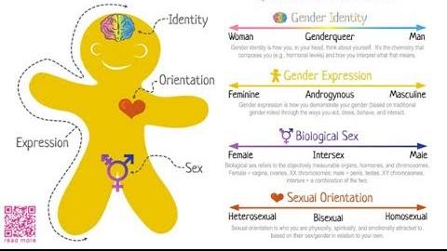
2. Core concepts

Slide 12
EQUALITY LAW:
what underlying normative aim?
Formal
Treating likes alike
Equal opportunities
Levelling the playing field
Substantive
Equality of results
Transformative
Tackling gender stereotypes

Slide 13
Different conceptions of equality
Formal equality: two cases are treated equally: differences are not taken into account. Emphasis on the treatment, which should be equal if cases are equal. Unequal cases might be treated unequally.
Equal opportunities: emphasis is on the chances that should be equally offered/equal playing field
Substantive equality: equality in results, taking relevant differences into account => positive action geared towards full equality
Transformative equality: addressing structural patterns of gender discrimination (3rd level as conceptualized in CEDAW)

Slide 14
Combination of negative and positive obligations…
Negative obligations (prohibition to discriminate)
Equal Pay
Employment relations / professional education
Social benefits and social insurances related to paid work
Goods and services
Positive obligations (promoting equality)
Positive action
Protecting pregnancy and maternity
Work life balance
Note:
no clear division between negative and positive obligations
Limited to the scope of EU law as such

Slide 15
Concept of ‘gender’ in EU law
Gender is not defined. ‘Sex’ and ‘gender’ are used interchangeably
EU law took important steps in challenging the social construction of sex. Landmark cases:
- ECJ Dekker (1990): pregnancy discrimination = sex discrimination
- ECJ P/S (1996): Prohibition of sex discrimination includes gender reassignment, (also implies a recognition that sex is not static)
> but: Sexual orientation separate & EU law still anchored in m/f dichotomy

Slide 16
Concept of equality in EU gender equality law
Formal equality: treating likes alike
Substantive equality: de facto equality
Asymmetric
equality of opportunity / equality of results
Positive action
e.g.: C-136/95, Thibault (1998): ‘the result pursued by the Directive is substantive, not formal, equality.’ (par. 26).
EU law contains spectrum of equality concepts, but formal equality remains dominant

Slide 17
Forms of discrimination recognized in EU gender equality law
Direct discrimination
Indirect discrimination
(Sexual) harassment
Victimization (= retaliation)
Instruction to discriminate
Discrimination by association
Intersectional discrimination

Slide 18
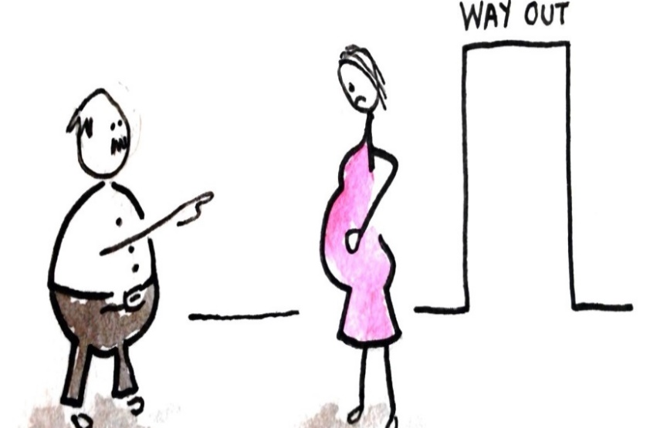
Direct discrimination - definition
‘direct discrimination’: where one person is treated less favourably on grounds of sex than another is, has been or would be treated in a comparable situation;
Elements:
Less favourable treatment
On grounds of sex
Comparability ( is problematic)
Direct sex discrimination cannot be justified, unless a legislative exception applies
Notes:
Grew out of ECJ case law, now definition in directives
The less favourable treatment should fall within the material scope of EU gender equality law. For example, access to employment, including promotion and training; employment conditions, including pay; social security; access to goods and services.
Directives:
Art 2(1)(a) Directive 2006/54/EC (Recast)
Art 2(a) Directive 2004/113/EC (Goods & Services)
Art 3(A) Directive 2010/41/EU (Self-Employment)
Exceptions: Closed system of exceptions:
Protection of women in relation to pregnancy and motherhood
Positive action
Genuine and determining occupational requirement: Art. 14(2) Recast Directive (to be interpreted strictly)

Slide 19
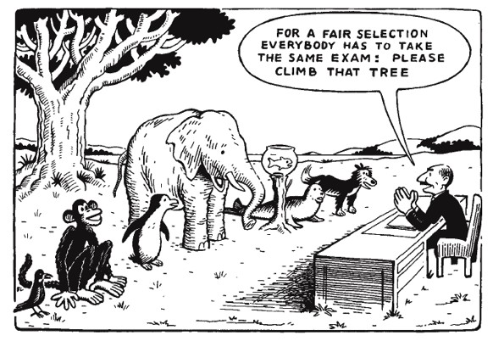
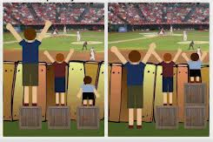

Indirect discrimination

Slide 20
Indirect discrimination - definition
‘where an apparently neutral provision, criterion or practice would put persons of one sex at a particular disadvantage compared with persons of the other sex, unless that provision, criterion or practice is objectively justified by a legitimate aim and the means of achieving that aim are appropriate and necessary’
Focus in on impact/effect in practice
Apparent neutrality
Particular disadvantage
(Absence of) Objective Justification
Notes:
Contrary to direct discrimination, indirect discrimination is not immediately obvious. It is based only indirectly on the prohibited criterion.
Example: a measure that would affect part-time employees
Art 2(1)(b) Dir. 2006/54/EC
Art 2(b) Dir. 2004/113/EC

Slide 21

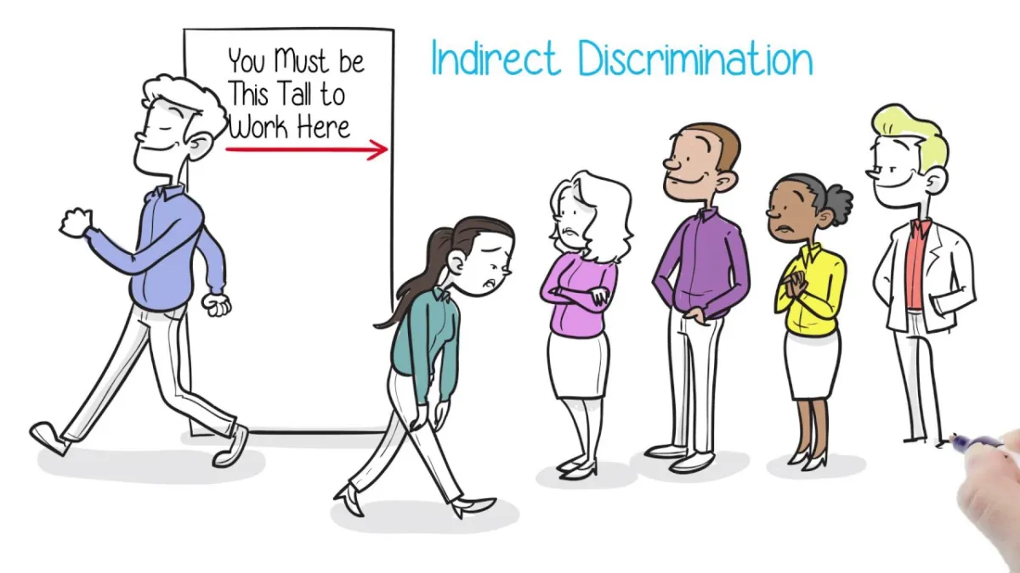
Notes:
Key cases: Bilka and Kalliri

Slide 22

(Sexual) Harassment

Slide 23
Sexual harassment - definition
‘sexual harassment’: … any form of unwanted verbal, non-verbal or physical conduct of a sexual nature occurs, with the purpose or effect of violating the dignity of a person, in particular when creating an intimidating, hostile, degrading, humiliating or offensive environment;
1. Sexual nature
2. Dignity
3. Environment

Slide 24
(Sexual) Harassment
No comparator required
Harassment and sexual harassment cannot be justified!
Not much case law from the CJEU yet, but more developments at national level (also due to more societal debate and recognition).

Slide 25
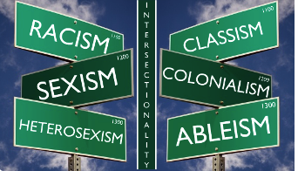
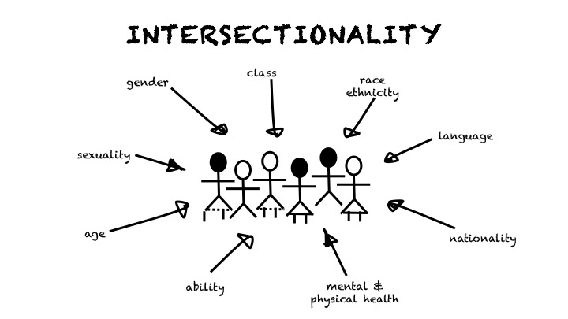
Intersectional discrimination
CEDAW, GR 28, par. 18: ‘the discrimination of women based on sex and gender is inextricably linked with other factors that affect women, such as race ethnicity, religion or belief, health, status, age, class, caste, sexual orientation and gender identity’.
-Very limited presence in EU law >problematic ‘headscarf’ cases
- First legislative reference in Pay Transparency Directive of 2023, Article 2E: ‘ discrimination based on a combination of sex and any other ground or grounds of discrimination protected under Directives 2000/43/EC or 2000/78/EC’
See also the preamble!

Slide 26

Structural discrimination: not (yet?) in EU law
‘[S]tructural or systemic discrimination refers to the set of norms, rules, routines, patterns, attitudes, and standards of behavior, both de jure and de facto, that give rise to a situation of inferiority and exclusion against a group of persons in a generalized sense, with these traits perpetuated over time and even generations. In other words, these are not isolated, sporadic, or episodic cases; rather it is discrimination that emerges from a historical, socioeconomic, and cultural context. Its generalized nature refers to its quantitative aspect, i.e., the large-scale nature of the problem, whereas it’s systemic nature refers to the way decisions, practices, policies, and the culture of a society are adopted. From this viewpoint, structural discrimination does not have a strict or narrow definition.’
(IACHR Compendium, p. 31)

Slide 27

Achievements and ideas for the future

Slide 28

Achievements
Assessment depends on one’s perspective: internal (‘law in the books’) or external (‘societal role of law’) viewpoint
Probably main achievement: impact on development of equality law at national level (for more info see www.equalitylaw.eu!)
Expanding reach: from equal pay to so much more
Specific points:
Strong protection against sex discrimination in employment and other areas.
Recognition

Slide 29

Looking forward
EU Gender Equality Law is entering a new area
Overarching challenge: how to develop law capable of reaching structural forms of inequality?
Deepening current norms > e.g. prohibition of indirect discrimination and prohibition of instruction to discriminate have more potential
Introducing new substantive norms? > E.g. Explicitly recognizing the concepts of institutional and structural discrimination.
New directive?

Slide 30
Grazie mille!
You can reach me at a.s.h.timmer@uu.nl

